Slide 1
Read and write CSV files from pandas DataFrames

Slide 2
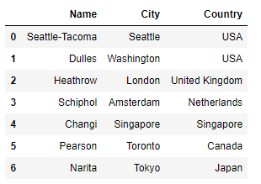
read_csv loads a DataFrame from a CSV
airports_df = pd.read_csv('Data/airports.csv')
airports.csv
airports_df
Name,City,Country
Seattle-Tacoma,Seattle,USA
Dulles,Washington,USA
Heathrow,London,United Kingdom
Schiphol,Amsterdam,Netherlands
Changi,Singapore,Singapore
Pearson,Toronto,Canada
Narita,Tokyo,Japan

Slide 3
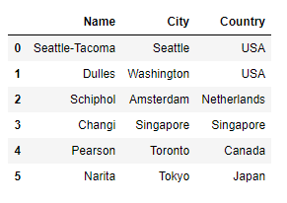
Rows with an extra , or other issues cause an error and the file does not load
Specify error_bad_lines=False to skip rows with errors
airports_df = pd.read_csv('Data/airportsInvalidRows.csv',
error_bad_lines=False)
airportsInvalidRows.csv
airports_df
Name,City,Country
Seattle-Tacoma,Seattle,USA
Dulles,Washington,USA
Heathrow,London , , United Kingdom
Schiphol,Amsterdam,Netherlands
Changi,Singapore,Singapore
Pearson,Toronto,Canada
Narita,Tokyo,Japan

Slide 4
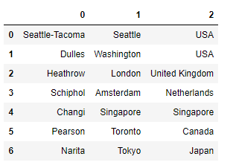
If the first row does not contain column headers specify header=None
airports_df = pd.read_csv('Data/airportsNoHeaderRows.csv',
header=None)
airportsNoHeaderRows.csv
airports_df
Seattle-Tacoma,Seattle,USA
Dulles,Washington,USA
Heathrow,London,United Kingdom
Schiphol,Amsterdam,Netherlands
Changi,Singapore,Singapore
Pearson,Toronto,Canada
Narita,Tokyo,Japan

Slide 5
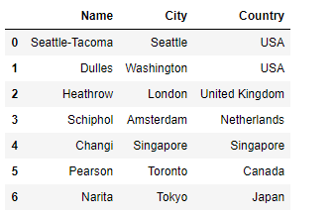
Provide names for the columns with the names parameter
airports_df = pd.read_csv('Data/airportsNoHeaderRows.csv',
header=None,
names=['Name','City','Country'])
airportsNoHeaderRows.csv
airports_df
Seattle-Tacoma,Seattle,USA
Dulles,Washington,USA
Heathrow,London,United Kingdom
Schiphol,Amsterdam,Netherlands
Changi,Singapore,Singapore
Pearson,Toronto,Canada
Narita,Tokyo,Japan

Slide 6
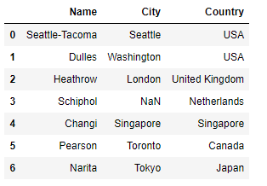
Missing values appear as NaN
airports_df = pd.read_csv('Data/airportsBlankValues.csv')
airportsBlankValues.csv
airports_df
Name,City,Country
Seattle-Tacoma,Seattle,USA
Dulles,Washington,USA
Heathrow,London,United Kingdom
Schiphol,,Netherlands
Changi,Singapore,Singapore
Pearson,Toronto,Canada
Narita,Tokyo,Japan

Slide 7
Use to_csv to write the contents of a DataFrame to a CSV file
airports_df.to_csv('Data/MyNewCSVFile.csv')
airports_df
MyNewCSVFile.csv
,Name,City,Country
0,Seattle-Tacoma,Seattle,USA
1,Dulles,Washington,USA
2,Heathrow,London,United Kingdom
3,Schiphol,,Netherlands
4,Changi,Singapore,Singapore
5,Pearson,Toronto,Canada
6,Narita,Tokyo,Japan

Slide 8
Specify index=False if you do not want to include the index column
airports_df.to_csv('Data/MyNewCSVFile.csv', index=False)
airports_df
MyNewCSVFile.csv
Name,City,Country
Seattle-Tacoma,Seattle,USA
Dulles,Washington,USA
Heathrow,London,United Kingdom
Schiphol,,Netherlands
Changi,Singapore,Singapore
Pearson,Toronto,Canada
Narita,Tokyo,Japan

